Slide 1
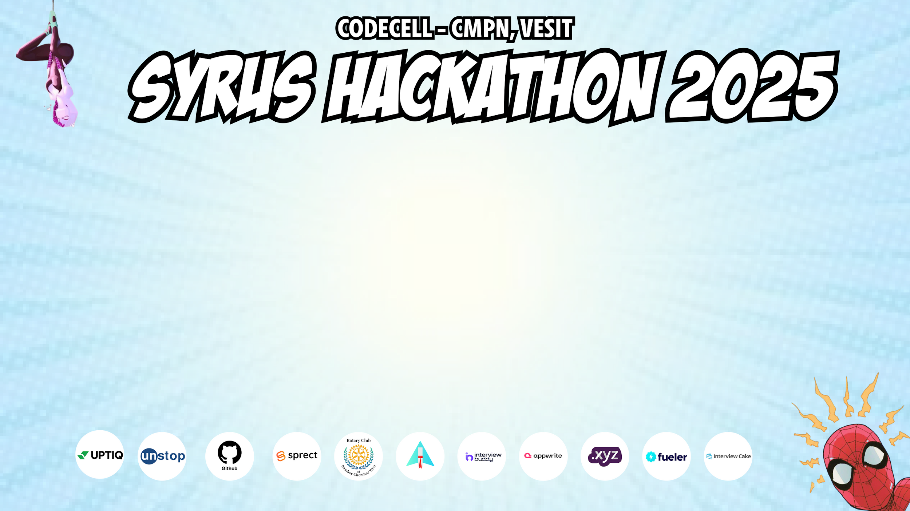
Category Code: C1
Problem Statement Title: AI-Powered Career Guidance Chatbot
Team Name: Nth time’s the charm
Institute Name: Vivekanand Education Society’s Institute of Technology

Slide 2

Idea / Approach details (& implemented features)
We propose an AI-powered chatbot that will: - Assess Users → Ask questions related to their skills, interests, and aspirations. - Analyze Market Trends → Fetch real-time job market data and growth potential of different careers. - Match Users to Careers → Use AI algorithms to suggest the best career paths based on their inputs. - Provide Roadmaps → Offer step-by-step guidance, required courses, and industry insights. - Interactive & Continuous Learning → Users can keep updating their skills and get better recommendations over time.

Slide 3
Innovation (Showstopper)
1️. AI-Powered Career Path Prediction – Suggests careers & skills based on user data. 2️. Real-Time Job Matching – Fetches jobs/internships from LinkedIn, Indeed, etc. 3️. Voice & Multimodal Chatbot – Supports voice-based interaction & text-to-speech. 4️. Career Trend Insights – Analyzes market trends & future job forecasts. 5️. Smart Resume Builder & Skill Gap Analysis – AI improves resumes & suggests courses. 6️. Gamified Learning – Career quizzes, challenges & rewards for engagement. 7️. Multi-Channel Support – Works on WhatsApp, Slack & Chrome Extension.

Slide 4
Tech Stack
1️. Frontend (React) – Sleek & Colorful UI
User-friendly UI: Built with React, designed for an engaging and intuitive experience.
Chat Interface: Interactive chatbot UI with quick replies and auto-suggestions.
Chat Interface: Interactive chatbot UI with quick replies and auto-suggestions.
2️. Backend (Node.js + Express)
Chatbot Engine: NLP-powered responses for career-related queries.
Database (MongoDB): Stores user profiles, past conversations, and recommendations.
API Integrations: Fetches career trends, job postings, and course recommendations.
3️. AI & Data Processing
NLP Integration: Uses an AI model to analyze user queries and provide relevant guidance.
Personalized Career Paths: Suggests careers based on skills, interests, and industry demand.
Multi-Channel Support: Integrated with WhatsApp & Slack for wider accessibility.

Slide 5
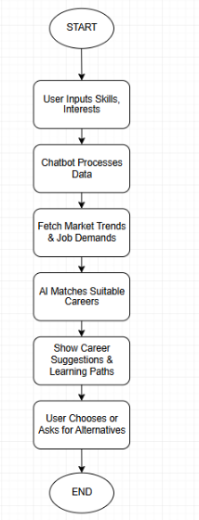
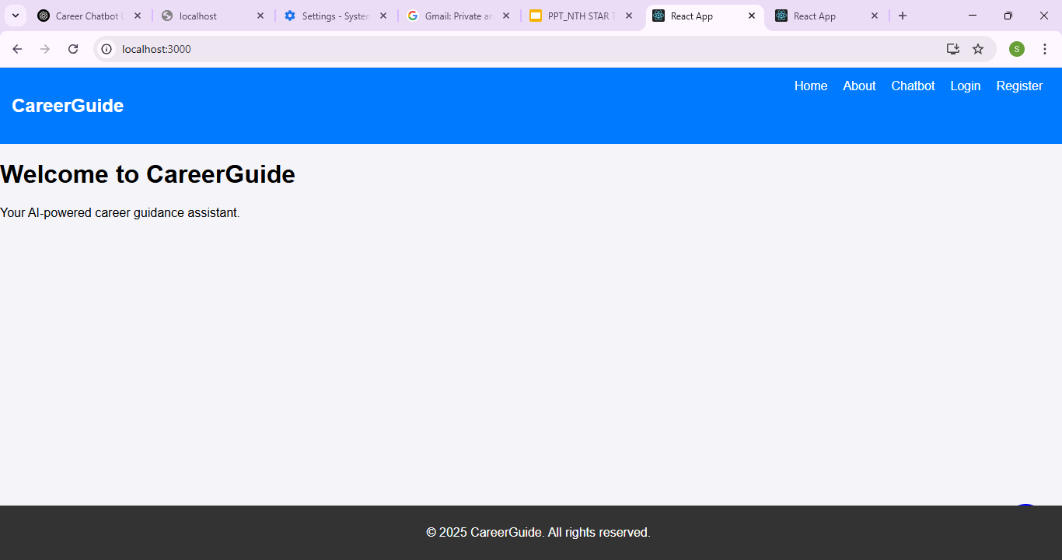
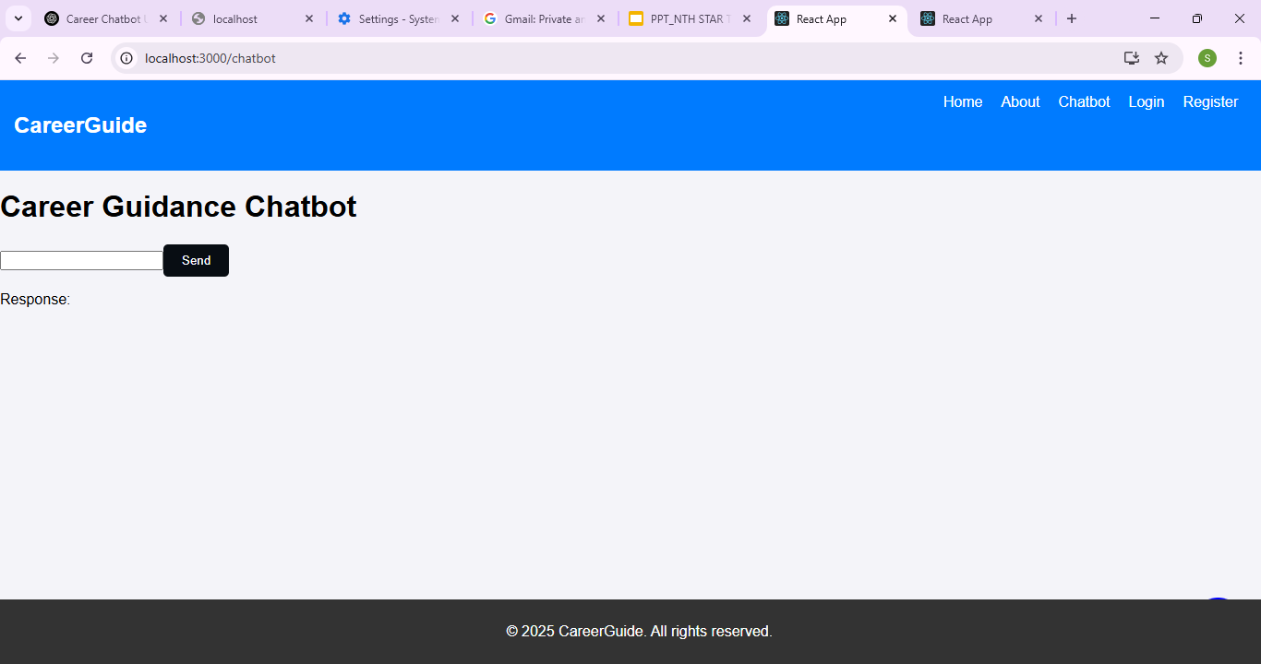
Implementation/Prototype/Use Case Diagram (screenshots)

Slide 6
Future Objectives
Enhance AI & NLP – Improve chatbot intelligence for deeper career insights.
Advanced Job Matching – Integrate AI-powered resume analysis & skill-based job suggestions.
Voice & Multilingual Support – Enable voice chat & multiple language support.
Personalized Learning Paths – AI-driven course & certification recommendations.
Industry Mentorship Feature – Connect users with professionals for guidance.
Gamification & Rewards – Expand career challenges & leaderboard system.
Blockchain for Verified Credentials – Securely store certifications & skill records.
Goal: Make career guidance smarter, interactive & more personalized.

